Slide 1

Unity Game Design Specifications
Team members: Anthony Jamora, Thomas Burke, Jonathan Nabors

Slide 2
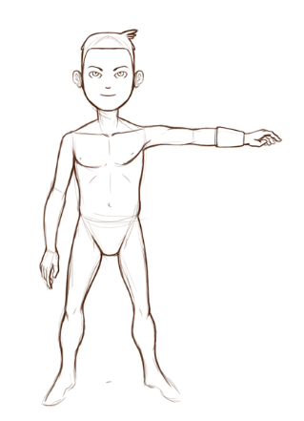
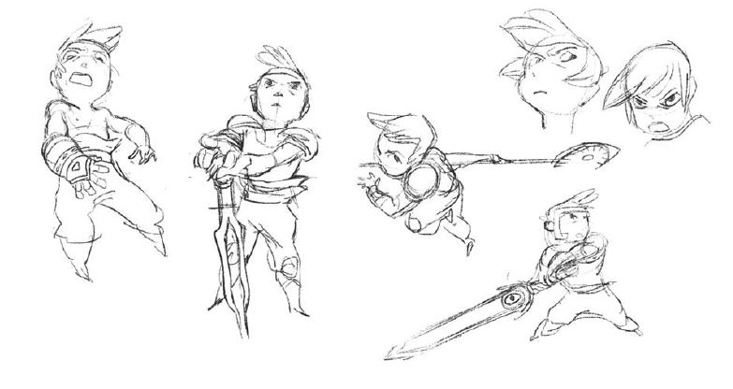
Game Description
Interactive, Immersive, Entertaining
Imaginative, original environments
Target audience is expecting:
Freedom to explore
Strong Storyline

Slide 3
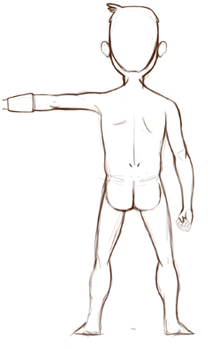
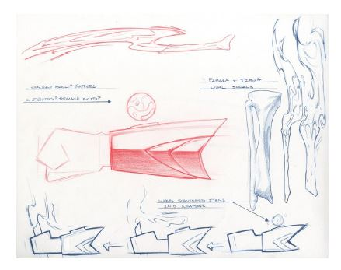
Functional Specifications
Rewards curious and adventurous players
Victory conditions
Winning
Losing
Game Elements
Health/Stamina
Obstacles
Items

Slide 4
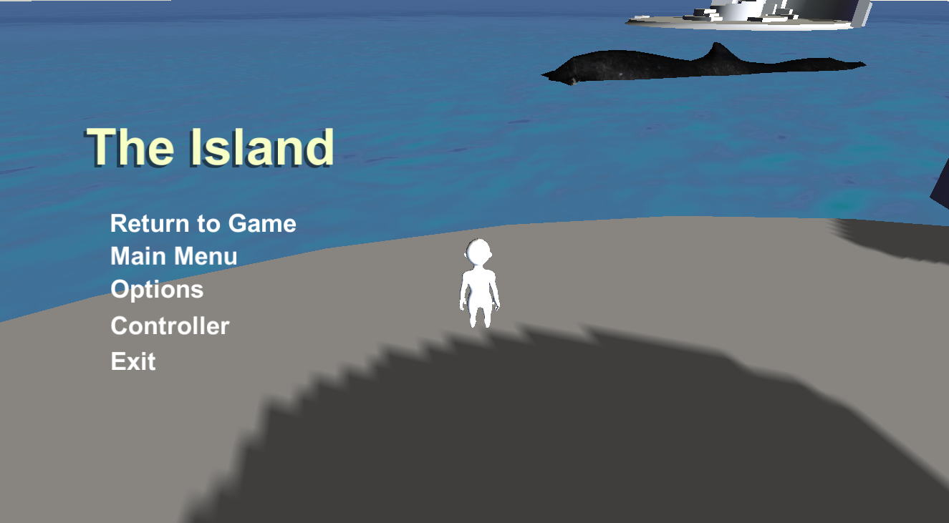
User Interface and Menus
Splash Screen
Menus
HUD
Brightness
70% - 130%
Resolution
16:9 Support
Graphics
Low-High

Slide 5
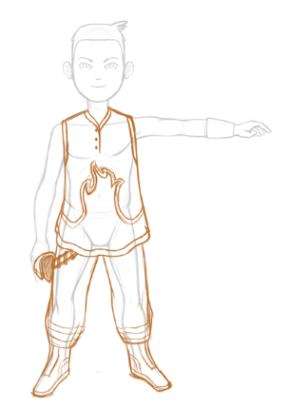
Main Menu Flow Diagram
Simple
Intuitive Navigation

Slide 6
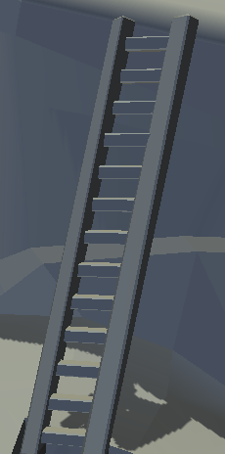
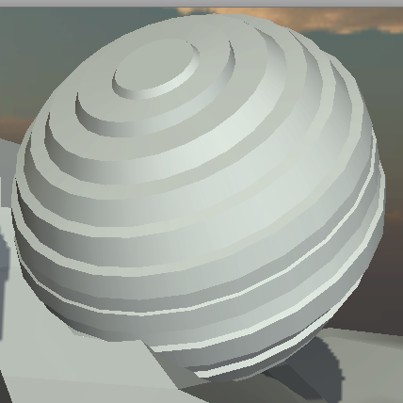

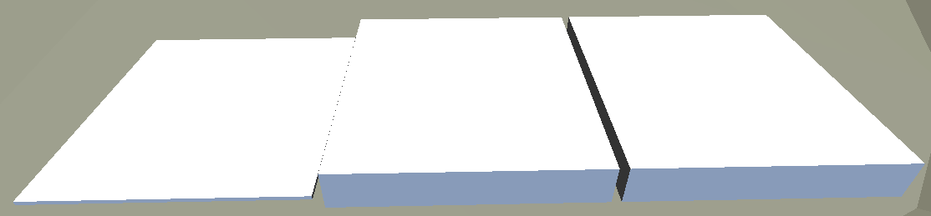
Art & Video
Obstacles
Terrain
Game Play Elements
Special Effects
Marketing and Packaging Art
Puzzles

Slide 7
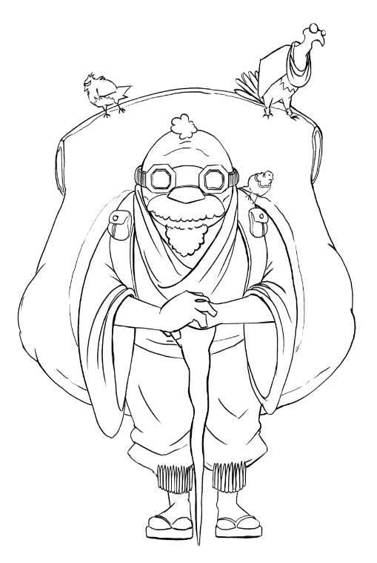
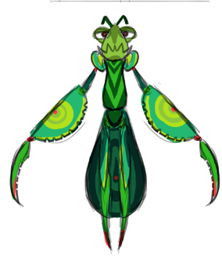
Sound and Music
Music
Ambiance
Combat
Menu
Sounds with animations
Sounds with particles
Grunts

Slide 9
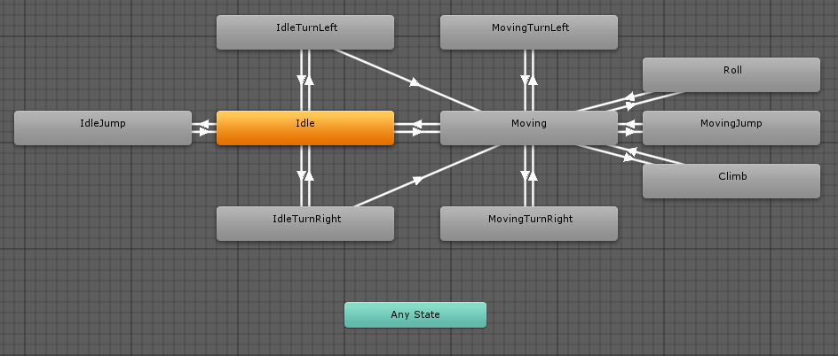
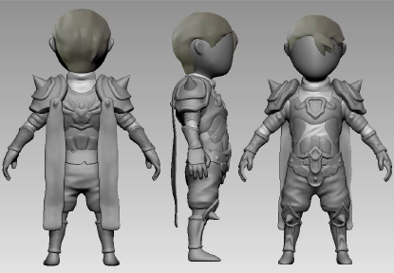
Characters
RigidBody
Capsule Collider
Player
Animator
Scripts
Friendly
Chat Bubble
Player State Machine

Slide 10
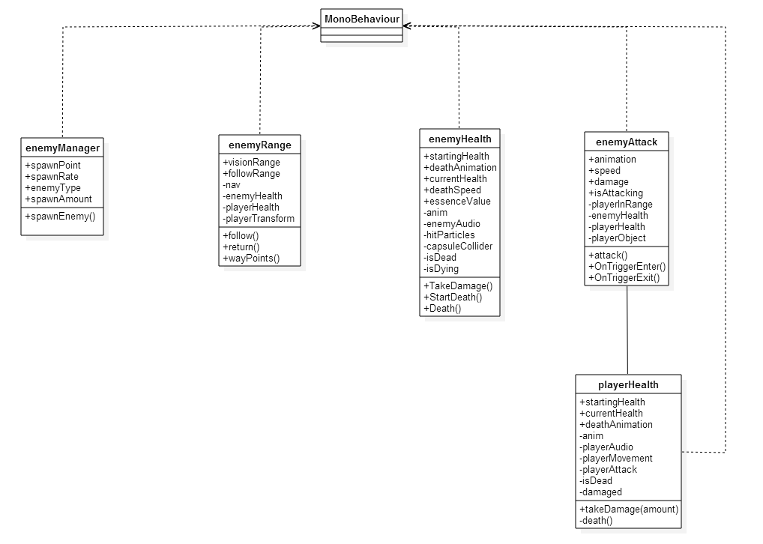
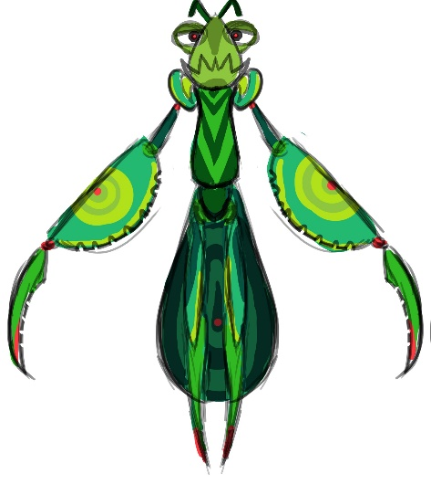

Characters Continued
Enemies
Enemy Range
Enemy Attack
Enemy Health

Slide 11
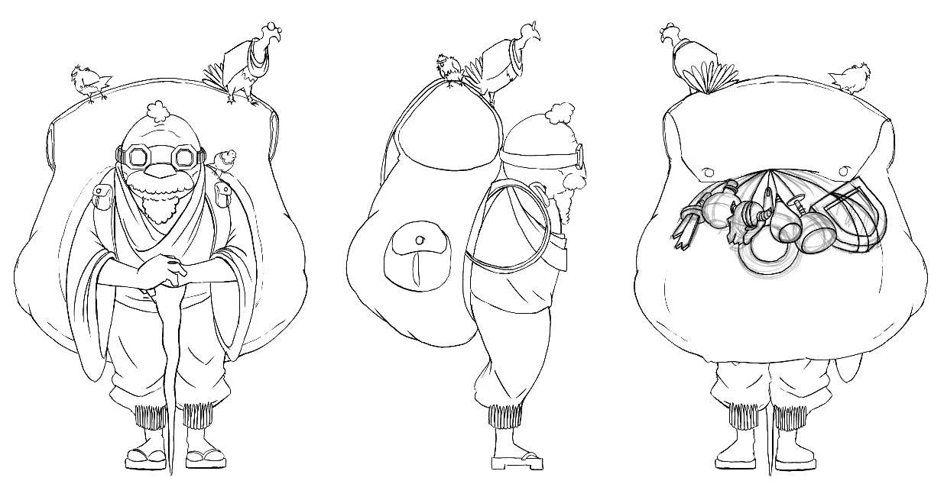
Technical Specifications
Naming Conventions
Scripts
For each Interaction
Structure
Game Objects Architecture
Transform
Rigidbody
Colllider
Script

Slide 12
Software Architecture

Slide 13
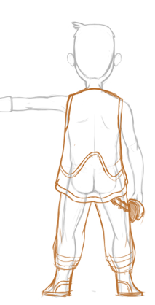
Technical Specifications continued
Artificial Intelligence
Vision Range
Return Range
Waypoints
Hardware Architecture
I/O devices
PC

Slide 14
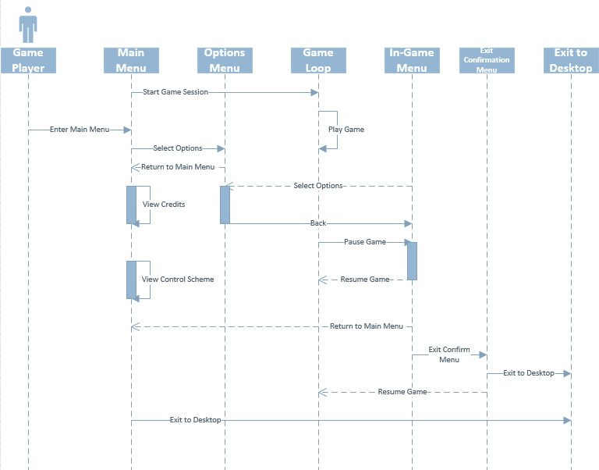
Use Cases
Actors
Menu Use Cases
Begin new game
Options
Credits
Exit Game
10 Total
Character Use Cases
Move
Attack
Use Item
Interact
12 Total

